Slide 1
Using Tag Questions

Slide 2
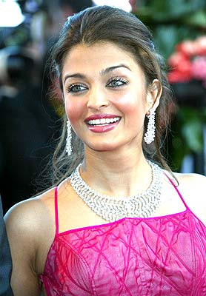
She's very beautiful, isn't she?

Slide 3
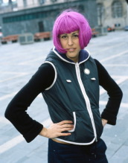
She's done something really interesting to her hair, hasn't she?

Slide 4
TAG QUESTIONS
A tag question is a question added at the end of a sentence. Speakers use it to make sure their information is correct.
Notes:
October 7th. 2006

Slide 5
What is a tag question?
A tag question is a sentence with a question phrase connected at the end.
Example:
It’s windy today, isn’t it?
Sentence part
Tag

Slide 6
Tag questions have two purposes:
To clarify information
(the speaker expects an answer)
Example:
We have a test tomorrow, don’t we?
Mr. Smith is coming to the meeting, isn’t he?

Slide 7
Tag questions have two purposes:
To agree with someone
(the speaker does not expect an answer)
Example:
You’re falling asleep, aren’t you?
The party was a lot of fun, wasn’t it?

Slide 8
Forming Tag Questions

Slide 9
Step 1:
Identify the verb in the sentence.
Sergio likes to eat at buffets, ______ __?
verb

Slide 10
Step 2:
Identify the type of verb.
(Is it the verb “to be”, an auxiliary verb, or the main verb?)
Sergio likes to eat at buffets, _____ ___?
Main verb

Slide 11
Step 3:
Identify the tense of verb.
(Is it in present or past tense?)
Sergio likes to eat at buffets, ______ ___?
Present tense

Slide 12
Step 4:
If in present tense, determine if 1st or 3rd person. If in past tense, use auxiliary “to be” or “do” in past.
Sergio likes to eat at buffets , _ _ ____?
Use the auxiliary verb “does”.
Third person

Slide 13
Step 5:
Is the verb affirmative or negative?
Sergio likes to eat at buffets, __________?
Write in the opposite.
doesn’t
Affirmative

Slide 14
Step 6:
Add the pronoun at the end.
Sergio likes to eat at buffets, doesn’t ?
he
Noun

Slide 15
Overview
Step 1: Identify the verb in the sentence.
Step 2: Identify the type of verb.
Step 3: Identify the tense.
Step 4: If in present tense, determine if 1st or 3rd person. If in past tense, use auxiliary “to be” or “do” in past.
Step 5: Affirmative or negative?
Step 6: Add pronoun.

Slide 16
Affirmative sentence + negative tag
Mary is here, isn’t she?
They have left, haven’t they?

Slide 17
1. She works for a big company, ____ _?
2. The movie started at 8:00, _____ ___?
3. This is a good apple, ____ _____?

Slide 18
Negative sentence + affirmative tag
Edy can’t sing, can he? You don’t like tea, do you?

Slide 19
Important Notes
In the present tense, if the subject is "I", the auxiliary changes to are or aren't.
I'm sitting next to you, aren't I?

Slide 20
Let’s Practice
wasn’t it
Lunch was delicious, ?
Spring break is next week, ______?
Class finished quickly, _________?
isn’t it
didn’t it

Slide 21
1. You don't have to work today, ___ ___?
2. She won't get here on time, _____ __?
3. Your dog hasn't had puppies, ____ ____?

Slide 22
Thank you for your attention

